Slide 1



Department of Computer Science and Engineering
Project Phase – II (18CSP83)
Review – 2
ENHANCING THE PERFORMANCE OF ANTIPHISHING MECHANISM USING MACHINE LEARNING
Group No.: 06 Batch No.: 2021_CSE_08
R Soumya 1KS18CS125
Sri Chandana P 1KS18CS098
Vijetha 1KS18CS117
Sushmitha S 1KS18CS106
Guided By:
Mr. Roopesh Kumar BN
Asst. Professor Dept of CSE
KSIT Bengaluru

Slide 2
Contents
Introduction
Problem Statement and Objectives
Methodology
Technologies and tools used
Implementation of Modules with codes
Results
Snapshots
References

Slide 3
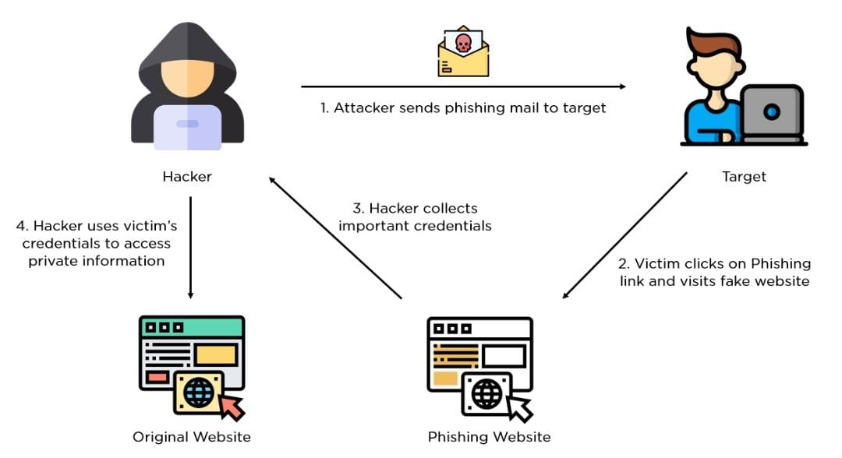
Introduction
The cyber security problems are increasing nowadays due to the growth of internet world wide, one of them is phishing.
In this attacker creates a replica of existing link or webpage to fool the user to get access to the personal information.
Phishers use multiple methods, including email, uniform resource locators(URL), instant messages, to steal user information.
Figure 1: General flow of Phishing

Slide 4
Introduction
The success mainly depends on recognizing phishing websites accurately and within an acceptable timescale.
The ML based phishing techniques depend on website functionalities to gather information that can help classify websites for detecting phishing sites. Here some common supervised learning techniques are applied to accurately detect phishing websites.

Slide 5
Problem Statement and Objectives
“To design the machine learning model that enhances the performance of anti-phishing mechanism”.
OBJECTIVES
To design a model that detects the phishing websites accurately.
To prevent the identity theft of the online users.

Slide 6
Methodology
Data Acquisition
Dataset is collected from UCI and Kaggle websites.
No. of records= 11056
Training dataset size= 75% (8292)
Test dataset size= 25% (2764)

Slide 7
Methodology
Previous work done :
Data Visualization for the dataset.
Implemented CNN module :
The CNNs are used to learn sequential information from the URL.
This model involves feature extraction and classification.
The accuracy of this model is obtained by using different layers in CNN.
Accuracy graph is plotted.

Slide 8
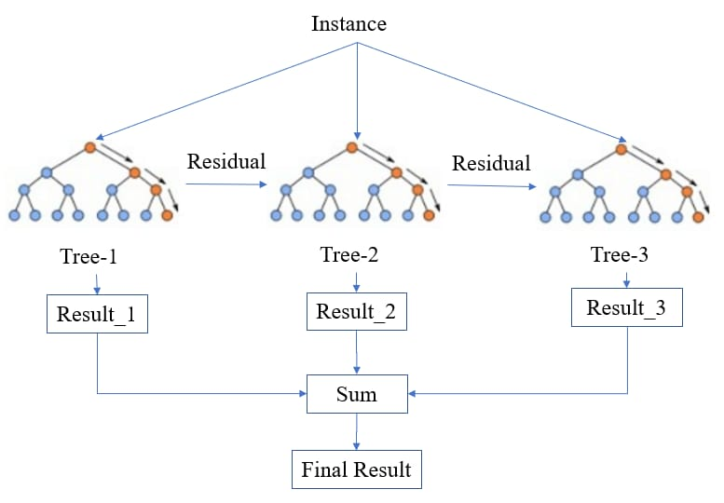
Methodology
XGBoost:
Boosting is a technique to build strong classifier from several weak classifiers in series.
XGBOOST is tree based model that aggregates trees using the boosting technique.

Slide 9

Methodology
Each tree predicts the similarity score in the form of
Similarity Score= (Sum of residuals)²
No. of residuals +λ
The prediction model (y) can be written as the aggregation of all the prediction score for each tree for a sample(x). For i-th sample
Where, ${ y}_{i}=\sum_{k}^{k}{f_{k}}\left(x_{k}\right)$
By combining many trees using technique like boosting, the predictive performance of trees can be improved substantially.

Slide 10

Methodology
The final prediction score of the model is obtained by summing the predictive score of individual tree. The predictive value at step t of the training can be written as
${\hat{y}}_{i}^{\left(t\right)}= {\hat{y}}_{i}^{\left(t−1\right)}+$ $f_{t}\left(x_{i}\right)$
So here every newest tree is created to compensate for the instances of the websites wrongly predicted.
Thus a model with high predictive power is obtained.

Slide 11
Technologies and tools used
Software Requirements
Windows 10
Python 3.9.7
Anaconda 4.10.3
Libraries Used:
Numpy
Pandas
Keras
Tensorflow
Matplotlib

Slide 12
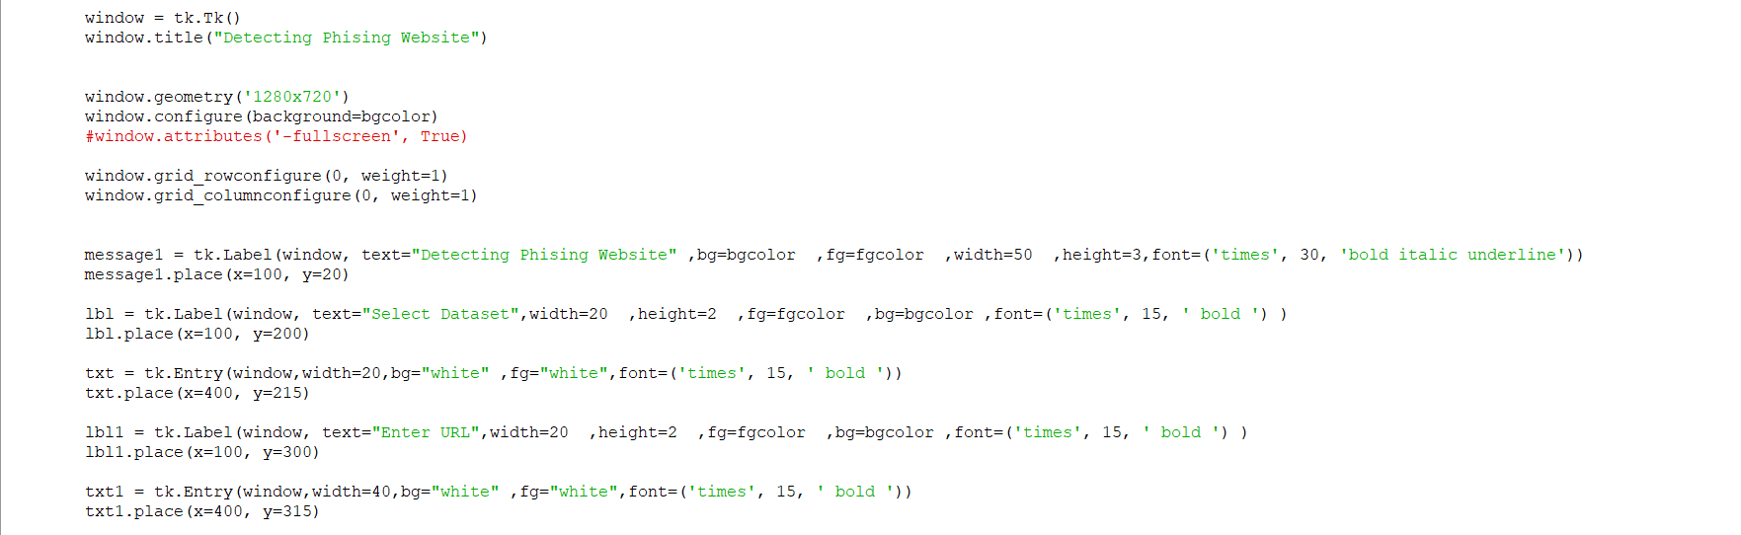
Implementation of modules with codes
Development Code

Slide 13
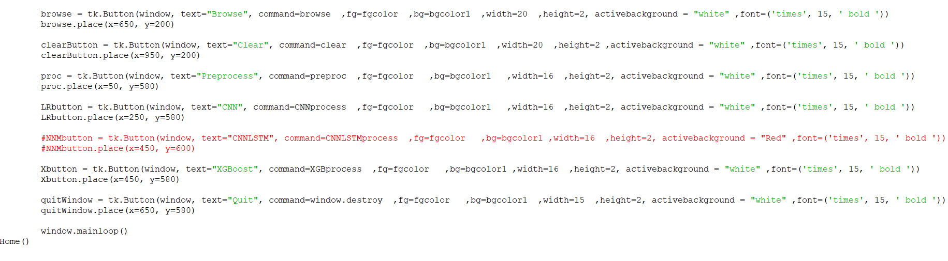
Implementation of modules with codes
Development Code

Slide 14
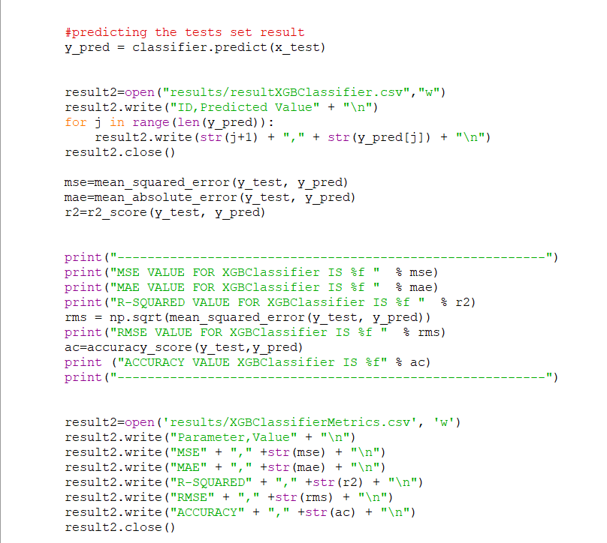
Implementation of modules with codes
Predicting the tests set result of XGBoost

Slide 15
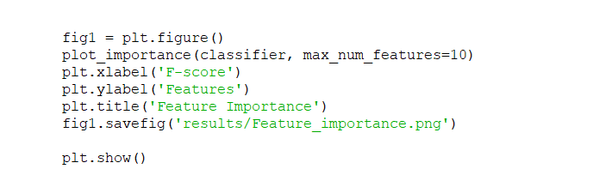
Implementation of modules with codes
Feature Importance code

Slide 16
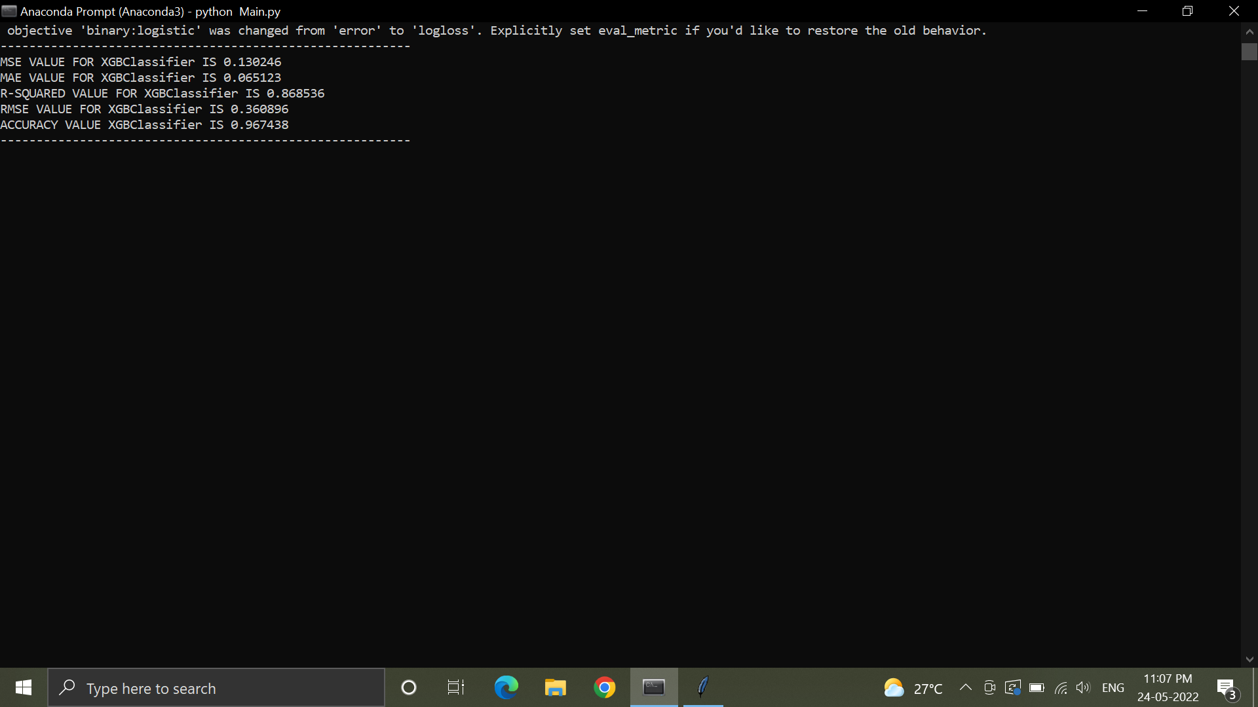
Results

Slide 17
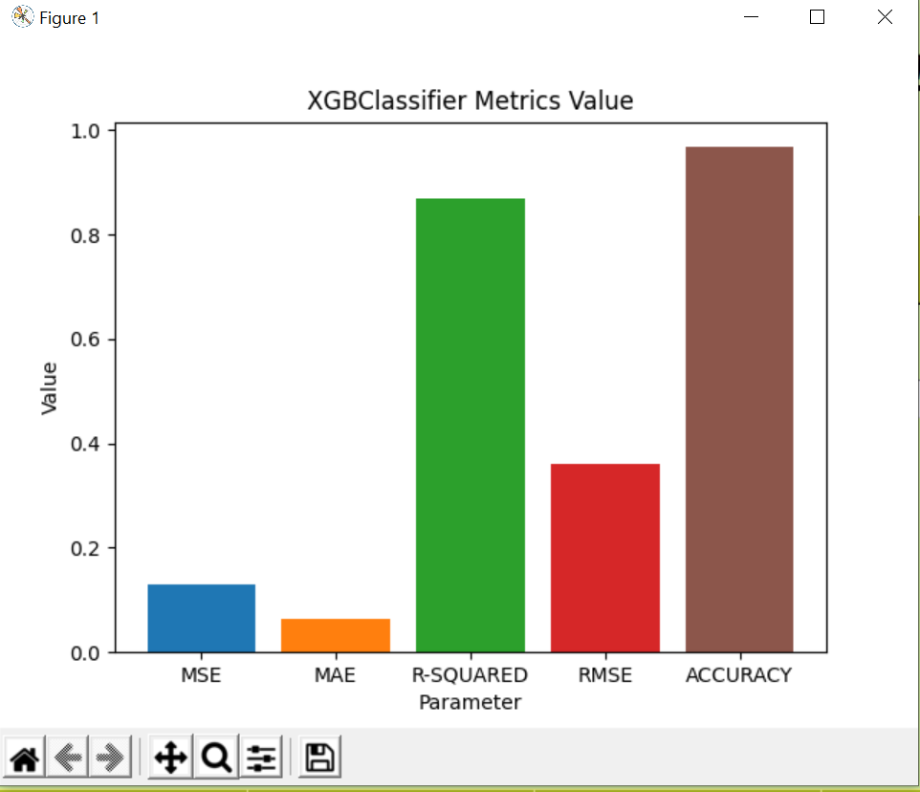
Results

Slide 18
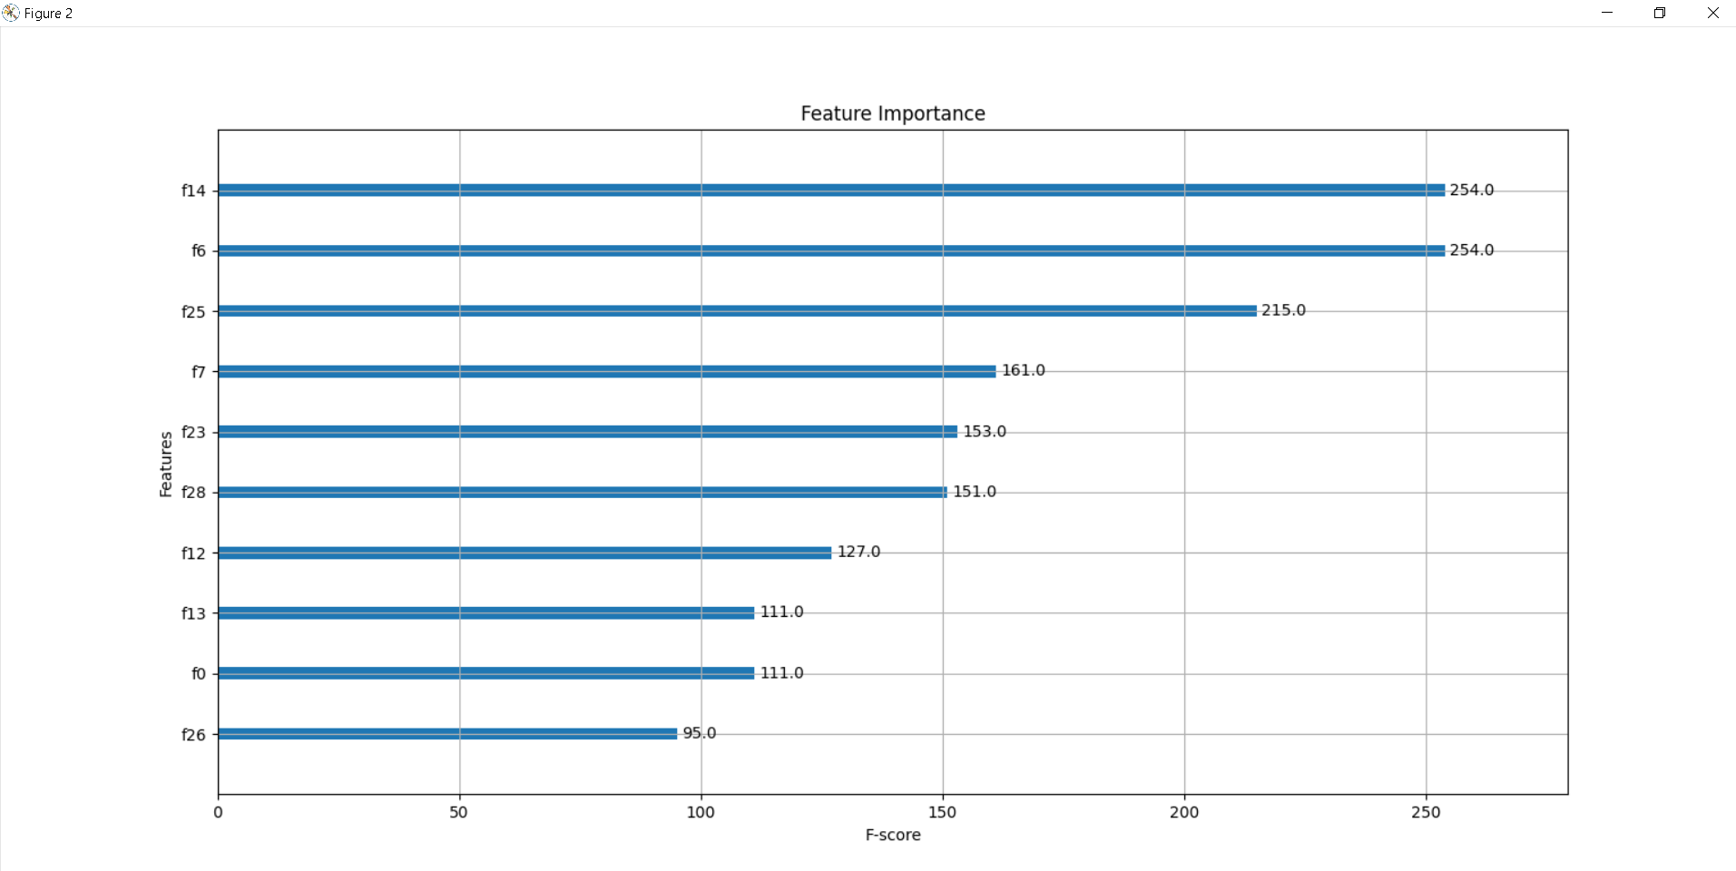
Snapshots

Slide 19
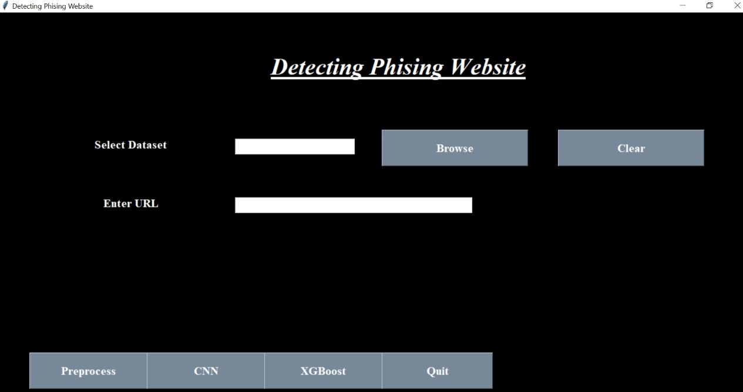
Snapshots

Slide 20
References
[1] A S S V Lakshmi Pooja, Sridhar.M, “Analysis of Phishing Website Detection Using CNN and Bidirectional LSTM ”, in Fourth International Conference on Electronics, Communication and Aerospace Technology (ICECA-2020) IEEE Xplore Part Number: CFP20J88-ART; ISBN: 978-1-7281-6387-1, 2020.
[2] Jiaqi Gu, Hui Xu, “An Ensemble Method for Phishing Websites Detection Based on XGBoost”, in 14th International Conference on Computer Research and Development 15 March 2022.
[3] Hajara Musa, Dr.A.Y Gital, Mohzo Gideon Bitrus, Dr.Nurul Farhana Juma’ at “Boosting the Accuracy of Phishing Detection with Less Features Using XGBOOST”, in International Journal of Software & Hardware Research in Engineering Volume 8 Issue 2 February 2020.
Notes:
Arduino is an open-source product, software/hardware which is accessible and flexible to customers.
Arduino is flexible because of offering variety of digital and analog pins, SPI and PWM outputs.
Arduino is easy to use, connected to a computer via a USB and communicates using serial protocol.
Inexpensive, around 500 rupees per board with free authoring software.
Arduino has growing online community where lots of source code is available for use, share and post examples for others to use too. Arduino is Cross-platform, which can work on Windows, Mac or Linux platforms.
Arduino follows Simple, clear programming environment as C language.

Slide 21
THANK YOU
Notes:
Arduino is an open-source product, software/hardware which is accessible and flexible to customers.
Arduino is flexible because of offering variety of digital and analog pins, SPI and PWM outputs.
Arduino is easy to use, connected to a computer via a USB and communicates using serial protocol.
Inexpensive, around 500 rupees per board with free authoring software.
Arduino has growing online community where lots of source code is available for use, share and post examples for others to use too. Arduino is Cross-platform, which can work on Windows, Mac or Linux platforms.
Arduino follows Simple, clear programming environment as C language.

